Slide 1
Maps

Slide 2
Contents
HTML5 Google Maps
HTML5 Geolocations
HTML5 Local Storage
HTML5 Application cache

Slide 3
Google Maps
Google Maps is a free web mapping service by Google that provides various types of geographical information.
Google Maps has a JavaScript API to customize the maps and display them on your webpage.
Using Google Maps, one can.
Search for places or get directions from one place to another.
View and navigate through horizontal and vertical panoramic street level images of various cities around the world.
Get specific information like traffic at a particular point.
Google Maps provides an API using which you can customize the maps and the information displayed on them.

Slide 4
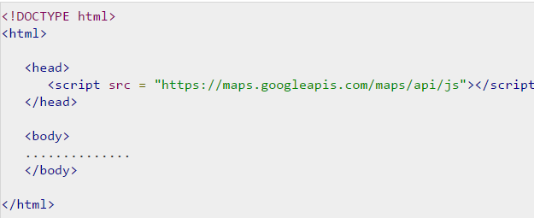
Steps to load maps
Step1: Create an HTML document
Step2:Load the API
Step3: Create a container:
<div id = "sample" style = "width:900px; height:580px;"></div>

Slide 5
Cont…
Step4:Map Options
Before initializing the map, we have to create a mapOptions object and set values for map initialization variables. A map has three main options, namely, centre, zoom, and maptypeid.
centre − Under this property, we have to specify the location where we want to centre the map. To pass the location, we have to create a LatLng object by passing the latitude and longitudes of the required location to the constructor.
zoom − Under this property, we have to specify the zoom level of the map.
maptypeid− Under this property, we have to specify the type of the map we want. Following are the types of maps provided by Google −
ROADMAP (normal, default 2D map)
SATELLITE (photographic map)
HYBRID (combination of two or more other types)
TERRAIN (map with mountains, rivers, etc.)

Slide 6
Cont…
Step5: Create Map Object: You can create a map by instantiating the JavaScript class called Map. While instantiating this class, you have to pass an HTML container to hold the map and the map options for the required map.
var map = new google.maps.Map(document.getElementById("sample"),mapOptions);
Step6: Load the Map
google.maps.event.addDomListener(window, 'load', loadMap); or <body onload = "loadMap()">

Slide 7
Types of Maps
Google Maps provides four types of maps. They are −
ROADMAP − This is the default type. If you haven't chosen any of the types, this will be displayed. It shows the street view of the selected region.
SATELLITE − This is the map type that shows the satellite images of the selected region.
HYBRID − This map type shows the major streets on satellite images.
TERRAIN − This is the map type that shows the terrain and vegetation
Syntax:
var mapOptions = { mapTypeId:google.maps.MapTypeId.Id of the required map type};

Slide 8
Example
<!DOCTYPE html>
<html>
<head>
<script src = "https://maps.googleapis.com/maps/api/js"></script>
<script>
function loadMap() {
var mapOptions = {
center:new google.maps.LatLng(17.609993, 83.221436),
zoom:12,
mapTypeId:google.maps.MapTypeId.ROADMAP
};
var map = new google.maps.Map(document.getElementById("sample"),mapOptions);
}
google.maps.event.addDomListener(window, 'load', loadMap);
</script>
</head>

Slide 9
Cont…
<body>
<div id = "sample" style = "width:580px; height:400px;"></div>
</body>
</html>

Slide 10
Google Maps UI
Google Maps provides a User Interface with various controls to let the user interact with the map. We can add, customize, and disable these controls.
Zoom − To increase and decease the zoom level of the map, we will have a slider with + and − buttons, by default. This slider will be located at the corner of left hand side of the map.
Pan − Just above the zoom slider, there will be a pan control for panning the map.
Map Type − You can locate this control at the top right corner of the map. It provides map type options such as Satellite, Roadmap, and Terrain. Users can choose any of these maps.
Street view − Between the pan icon and the zoom slider, we have a pegman icon. Users can drag this icon and place at a particular location to get its street view.

Slide 11
Geolocation
Geolocation is the identification or estimation of the real-world geographic location of an object, such as a radar source, mobile phone, or Internet-connected computer terminal.
HTML5 Geolocation API lets you share your location with your favorite web sites.
A Javascript can capture your latitude and longitude and can be sent to backend web server and do fancy location-aware things like finding local businesses or showing your location on a map.
The geolocation APIs work with a new property of the global navigator object ie. Geolocation object which can be created as follows:
var geolocation = navigator.geolocation;

Slide 12
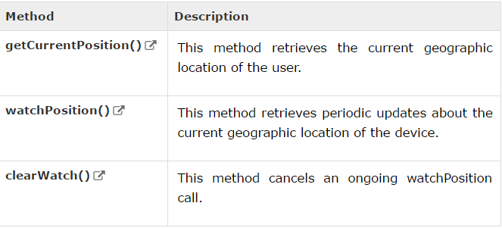
Geolocation methods

Slide 13
Location property
Geolocation methods getCurrentPosition() and getPositionUsingMethodName() specify the callback method that retrieves the location information.
These methods are called asynchronously with an object Position which stores the complete location information.
The Position object specifies the current geographic location of the device.
The location is expressed as a set of geographic coordinates together with information about heading and speed.

Slide 14
Geolocation methods
getCurrentPosition()
The getCurrentPosition method retrieves the current geographic location of the device. The location is expressed as a set of geographic coordinates together with information about heading and speed. The location information is returned in a Position object.
getCurrentPosition(showLocation, ErrorHandler, options);

Slide 15
Perameters
showLocation − This specifies the callback method that retrieves the location information. This method is called asynchronously with an object corresponding to the Position object which stores the returned location information.
ErrorHandler − This optional paramter specifies the callback method that is invoked when an error occurs in processing the asynchronous call. This method is called with the PositionError object that stores the returned error information.
options − This optional paramter specifies a set of options for retrieving the location information. You can specify (a) Accuracy of the returned location information (b) Timeout for retrieving the location information and (c) Use of cached location information .

Slide 16
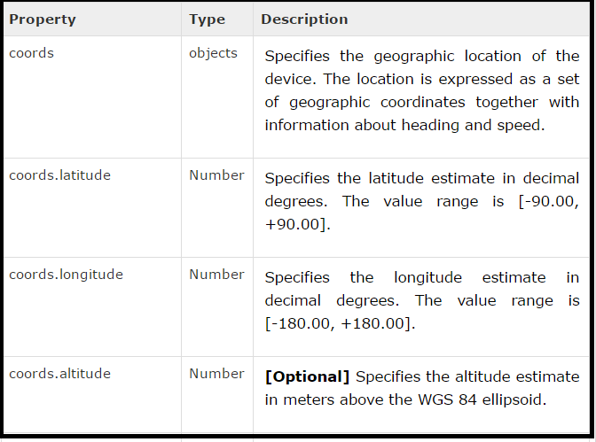
Cont…

Slide 17
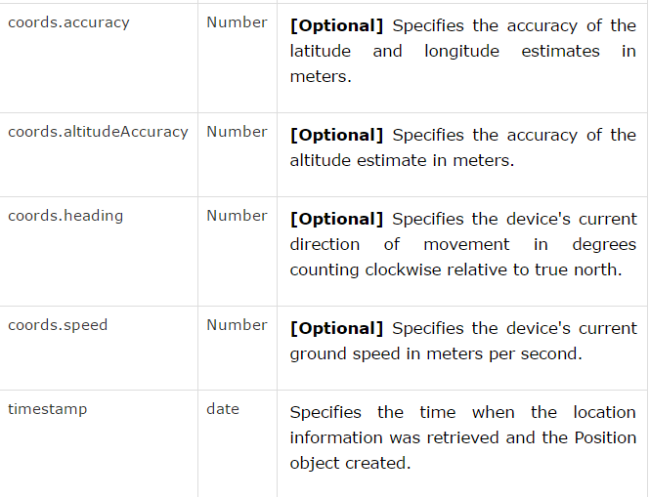
Cont…

Slide 18
Geolocation watchposition() API
The watchPosition method retrieves periodic updates about the current geographic location of the device.
The location is expressed as a set of geographic coordinates together with information about heading and speed.
The location information is returned in a Position object. Each update returns a new Position object.
Syntax:
watchPosition(showLocation, ErrorHandler, options);

Slide 19
Cont…
The watchPosition method retrieves periodic updates about the current geographic location of the device. The location is expressed as a set of geographic coordinates together with information about heading and speed.
The location information is returned in a Position object. Each update returns a new Position object.

Slide 20
Parameters
showLocation − This specifies the callback method that retrieves the location information. This method is called asynchronously with an object corresponding to the Position object which stores the returned location information.
ErrorHandler − This optional paramter specifies the callback method that is invoked when an error occurs in processing the asynchronous call. This method is called with the PositionError object that stores the returned error information.
options − This optional paramter specifies a set of options for retrieving the location information. You can specify (a) Accuracy of the returned location information (b) Timeout for retrieving the location information and (c) Use of cached location information .

Slide 21
Return value
The watchPosition method returns a unique transaction ID (number) associated with the asynchronous call. Use this ID to cancel the watchPosition call and to stop receiving location updates.

Slide 22
Geolocation clearwatch() API
The clearWatch method cancels an ongoing watchPosition call.
When cancelled, the watchPosition call stops retrieving updates about the current geographic location of the device.
clearWatch(watchId);
watchId − This specifies the unique ID of the watchPosition call to cancel. The ID is returned by the watchPosition call.

Slide 23
Example on Google Maps and geolocations

Slide 24
ExAMPLE -1
Display the map image of a current location.

Slide 25
Show the image of current location
<html>
<head>
<title> Watching position
</title>
<script>
function geoFindMe() {
var output = document.getElementById("out");
if (!navigator.geolocation){
output.innerHTML = "<p>Geolocation is not supported by your browser</p>";
return;
}
function success(position) {
var latitude = position.coords.latitude;
var longitude = position.coords.longitude;
output.innerHTML = '<p>Latitude is ' + latitude + '° <br>Longitude is ' + longitude + '°</p>';
var img = new Image();
img.src="https://maps.googleapis.com/maps/api/staticmap?center=" + latitude + "," + longitude + "&zoom=13&size=300x300&sensor=false";
output.appendChild(img);
}

Slide 26
Cont…
function error() {
output.innerHTML = "Unable to retrieve your location";
}
output.innerHTML = "<p>Locating…</p>";
navigator.geolocation.getCurrentPosition(success, error);
}
</script>
</head>
<body>
<p><button onclick="geoFindMe()">Show my location</button></p>
<div id="out"></div>
</body>
</html>

Slide 27
Session storage
The Session Storage is designed for scenarios where the user is carrying out a single transaction, but could be carrying out multiple transactions in different windows at the same time.

Slide 28
Local storage
The Local Storage is designed for storage that spans multiple windows, and lasts beyond the current session. In particular, Web applications may wish to store megabytes of user data, such as entire user-authored documents or a user's mailbox, on the client side for performance reasons.
Again, cookies do not handle this case well, because they are transmitted with every request.

Slide 29
Delete web storage
Storing sensitive data on local machine could be dangerous and could leave a security hole.
The Session Storage Data would be deleted by the browsers immediately after the session gets terminated.
To clear a local storage setting you would need to call localStorage.remove('key'); where 'key' is the key of the value you want to remove. If you want to clear all settings, you need to call localStorage.clear() method.

Slide 30
ExAMPLE -1
Example on menaging web storage

Slide 31
Session storage
<!DOCTYPE HTML>
<html>
<body>
<script type="text/javascript">
if( sessionStorage.hits ){
sessionStorage.hits = Number(sessionStorage.hits) +1;
}
else{
sessionStorage.hits = 1;
}
document.write("Total Hits :" + sessionStorage.hits );
</script>
<p>Working with session storage</p>
</body>
</html>

Slide 32
Local storage
<!DOCTYPE HTML>
<html>
<body>
<script type="text/javascript">
if( localStorage.hits ){
localStorage.hits = Number(localStorage.hits) +1;
}
else{
localStorage.hits = 1;
}
document.write("Total Hits :" + localStorage.hits );
</script>
<p>Working with local storage</p>
</body>
</html>

Slide 33
Removing local storage
<!DOCTYPE HTML>
<html>
<body>
<script type="text/javascript">
localStorage.clear();
// Reset number of hits.
if( localStorage.hits ){
localStorage.hits = Number(localStorage.hits) +1;
}
else{
localStorage.hits = 1;
}
document.write("Total Hits :" + localStorage.hits );
</script>
<p>Removing data from local storage</p>
</body>
</html>

